Slide 1
CECS 326 Operating Systems
Processes
(Chapter 3. Operating system Concepts by Silberschatz, Galvin and Gagne)

Slide 2
Process Concept
Process – a program in execution; process execution must progress in sequential fashion; it represents a unit of work in a computer
A process consists of an address space and current state
Address space includes
Program code, also called the text section
Static data section, containing global variables
Stack containing temporary data (function parameters, return addresses, local variables)
Heap containing memory dynamically allocated during run time
Current state includes
Program counter
Processor registers

Slide 3
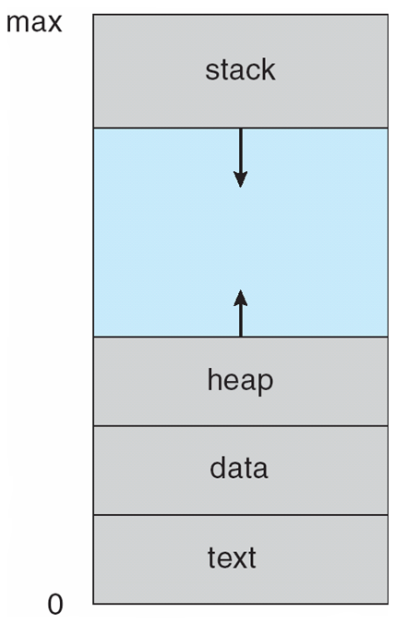
Process Concepts
Process in memory (address space)
Program is a passive entity stored on disk as an executable file, while process is active
A program becomes a process when the executable file is loaded into memory and a process control block (PCB) is created for its execution
Execution of a program can be started via GUI mouse clicks, command line entry of its name, etc.
We may have several processes executing the same program

Slide 4
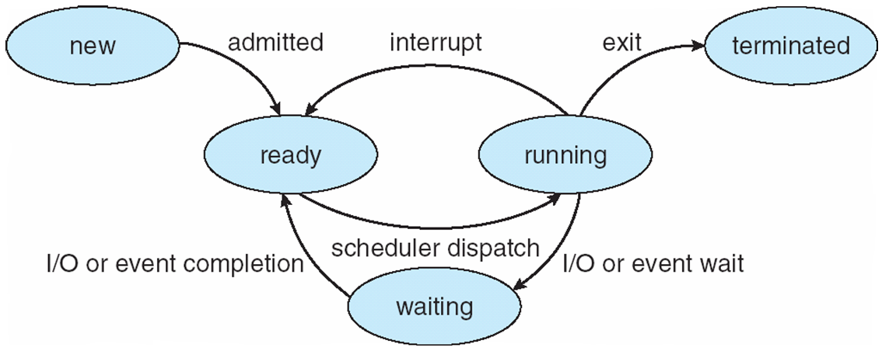
Process State
As a process execute, it changes state
New: the process is being created
Running: instructions are being executed
Waiting: the process is waiting for some event to occur
Ready: the process is waiting to be assigned a processor
Terminated: the process has finished execution

Slide 5
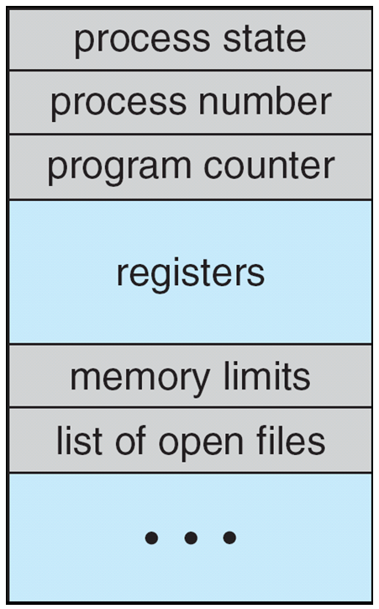
Process Control Block (PCB)
A data structure created to maintain information associated with each process, including
Process ID
Process state
Program counter
Registers
CPU scheduling information (priorities, scheduling queue pointers)
Memory management information (memory allocated to process)
Accounting information (CPU used, clock time elapsed since start, time limits)
I/O status information (I/O devices allocated to process, list of open files)

Slide 6
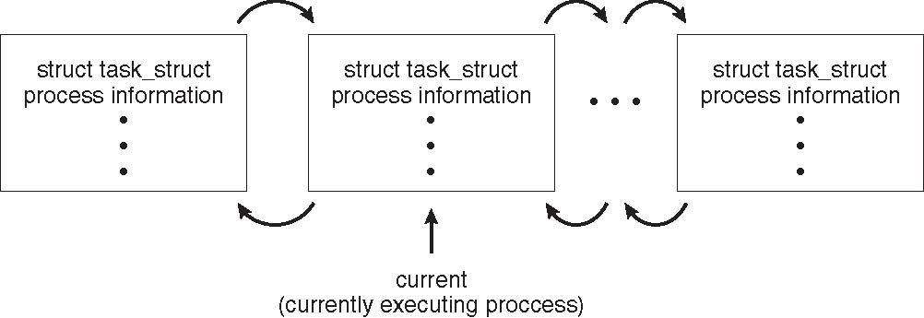
Process Representation in Linux
Represented by the C structure task_struct
pid t_pid; /* process identifier */ long state; /* state of the process */ unsigned int time_slice /* scheduling information */ struct task_struct *parent; /* this process’s parent */ struct list_head children; /* this process’s children */ struct files_struct *files; /* list of open files */ struct mm_struct *mm; /* address space of this process */

Slide 7
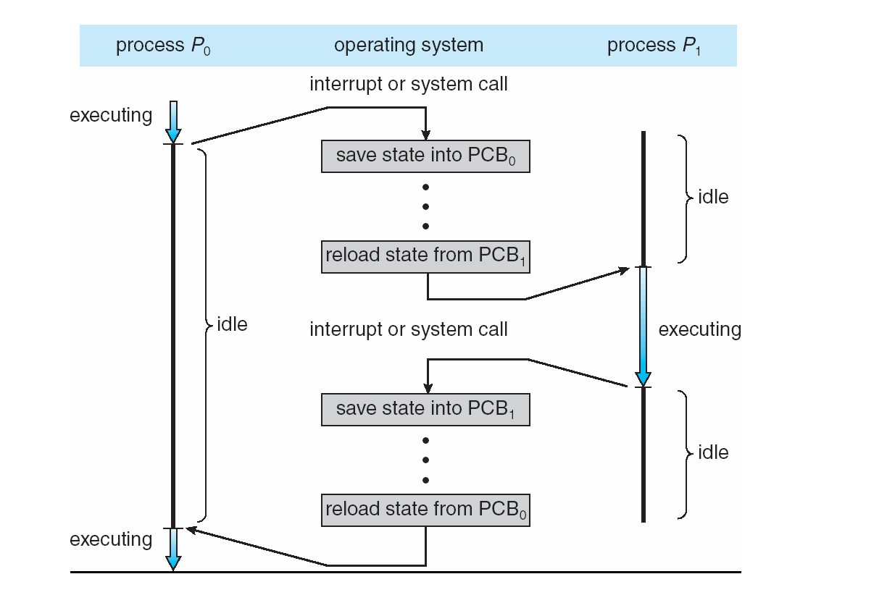
CPU Switch From Process to Process

Slide 8
Context Switch
When CPU switches to another process, the system must save the state of the old process and load the saved state for the new process via a context switch
Context of a process is represented in the PCB
Context switch time is overhead; the system does no useful work while switching. The more complex the OS and the PCB, the longer the context switch
Time in context switch highly dependent on hardware support. Some processors (e.g., Sun UltraSPARC) provide multiple sets of registers. In this case context switch often requires just changing the pointer to a different register set.

Slide 9
Process Scheduling
Maximize CPU use, quickly switch processes onto CPU for time sharing
Process scheduler selects among available processes for next execution on CPU
Maintains scheduling queues of processes
Job queue – set of all processes in the system
Ready queue – set of all processes residing in main memory, ready and waiting to execute
Device queues – set of processes waiting for an I/O device
Processes move among the various queues

Slide 10
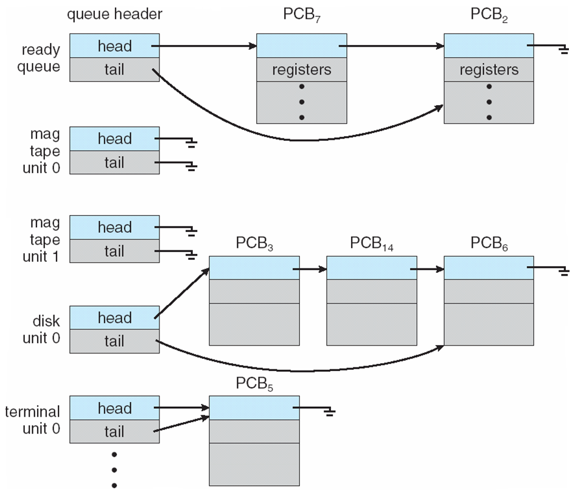
Ready Queue & Various I/O Device Queues

Slide 11
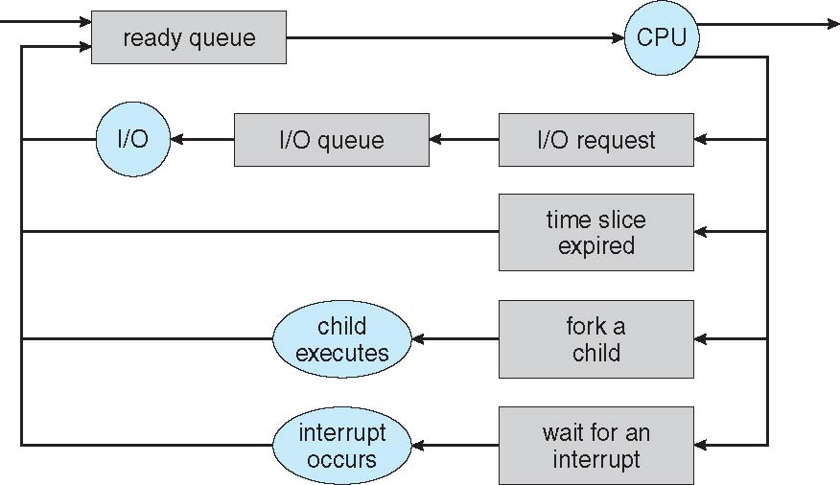
Representation of Process Scheduling

Slide 12
Operations on Processes
OS must provide mechanisms for
Process creation
Process termination
Interprocess communication

Slide 13
Process Creation
Parent process create child processes, which, in turn, create other processes, forming a tree of processes
A process is identified and managed via a process id (pid)
Resource sharing options
Parent and children share all resources
Children share subset of parent’s resources
Parent and children share no resources
Execution options
Parent and children execute concurrently
Parent waits until children terminate
Address space
Child duplicate of parent
Child has a program loaded into it

Slide 14
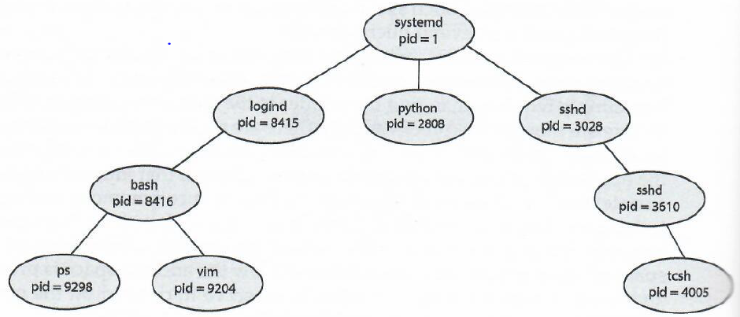
A Tree of Processes on a Typical Linux System

Slide 15
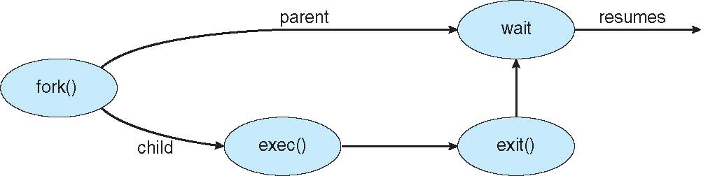
Process Creation
UNIX/Linux example
fork() system call creates new process
exec() system call used after a fork() to replace the process’ address space with a new program

Slide 16
C Program calling fork() and exec()
#include <sys/types.h>
#include <sys/wait.h>
#include <stdio.h>
#include <unistd.h>
int main () {
pid_t pid;
/* fork a child process */
pid = fork();
if (pid < 0) { /* error occurred */
fprintf(stderr, "fork failed");
return 1;
}
else if (pid == 0) { /* child process */
execlp("/bin/ls","ls",NULL);
}
else { /* parent process */
/* parent will wait for child to complete */
wait(NULL);
printf("child complete");
}
return 0;
}

Slide 17
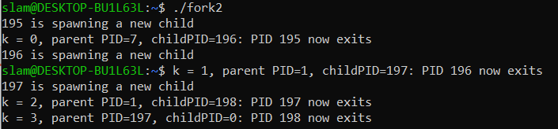
Hierarchy of Process Creation
Output of this program
#include <cstdlib>
#include <unistd.h>
#include <iostream>
using namespace std;
int main() {
int k;
long childPID;
for(k=0; k<3; k++) {
cout << getpid() << " is spawning a new child" << endl;
if(childPID = fork()) break;
}
cout << "k = " << k << ", parent PID=" << getppid()
<< ", childPID=" << childPID << ": PID " << getpid() << " now exits " << endl;
exit(0);
}

Slide 18
Process Termination
Process executes last statement, then asks OS to delete it using the exit() system call
Returns status data from child to the waiting parent (via wait())
Process’ resources are deallocated by OS
Parent may terminate the execution of a child process using the kill() system call. Some reasons for doing so:
Child has exceeded allocated resources or time
Task assigned to child is no longer required
Parent is exiting and the OS does not allow a child to continue if its parent terminates

Slide 19
Process Termination
Some operating systems do not allow child processes to exist if their parent has terminated
If a process terminates, then a cascading termination occurs. All children, grandchildren, etc., are terminated
The termination is initiated by the OS
Parent process may wait for termination of a child process by using a wait() system call. The call returns status information and the pid of the terminated process
pid = wait(&status);
A process that has completed its execution but its PCB has not yet removed, it becomes a zombie. A wait() system call invoked by its parent process completes this removal. If parent did not invoke wait(), the zombie will stay on
If parent did not invoke wait() and terminates, process is an orphan (some OS makes the root process parent of an orphaned process)

Slide 20

Multiprocess Architecture – Chrome Browser
Many web browsers ran as a single process
If one web site causes trouble, then the entire browser can hang of crash
Google Chrome Browser uses a multiprocess architecture that runs 3 types of processes:
Browser process manages user interface, disk and network I/O
Renderer process renders web pages, deals with HTML, Javascript
A new renderer is created for each website opened
Runs in sandbox restricting disk and network I/O, minimizing effect of security exploits
Plug-in process for each type of plug-in

Slide 21
Interprocess Communication
Processes within a system may be independent or cooperating
Cooperating process can affect or be affected by other processes (e.g., sharing data)
Reasons for cooperating processes:
Information sharing
Computation speedup
Modularity
Cooperating processes need interprocess communication (IPC)
Two common models of IPC
Shared memory
Message passing

Slide 22
Models of IPC
(a) Message passing (b) Shared memory

Slide 23
Producer-Consumer Problem
A paradigm for cooperating processes
Producer process produces information that is consumed by a consumer process
Cooperation via a shared buffer
Unbounded-buffer places no practical limit on the size of the buffer
Bounded-buffer assumes that there is a fixed buffer size

Slide 24
Bounded-Buffer – A Shared-Memory Solution
Shared data
#define BUFFER_SIZE 10
typedef struct {
. . .
} item;
item buffer [BUFFER_SIZE];
int in = 0;
int out = 0;

Slide 25
Bounded-Buffer
Producer
item next_produced;
while (true) {
/* produce an item in next_produced */
while (((in + 1)%BUFFER_SIZE) == out)
; /* do nothing */
buffer[in] = next_produced;
in = (in + 1)%BUFFER_SIZE;
}
Consumer
item next_consumed;
while (true) {
while (in == out)
; /*buffer empty, do nothing */
next_consumed = buffer[out];
out = (out + 1)%BUFFER_SIZE;
/* consume the item in next_consumed */
}
Solution is correct with one producer and one consumer, but can only use BUFFER_SIZE-1 slots in buffer
0
N-1
In
out

Slide 26
IPC – Shared Memory
An area of memory shared among processes that wish to communicate
Communication is under the control of cooperating processes, not the OS
Major issue is to provide mechanism that will allow user processes to synchronize their actions when they access the shared memory
Synchronization to be covered in a later chapter

Slide 27
IPC – Message Passing
Message passing - mechanism for processes to communicate and to synchronize their actions
Message system – processes communicate with each other without resorting to shared variables
IPC facility provides two operations:
send(message)
receive(message
Message size may be fixed or variable

Slide 28
Message Queue on Linux
// use_msgQ.cpp
#include <sys/types.h>
#include <sys/ipc.h>
#include <sys/msg.h>
#include <string.h>
#include <iostream>
#include <unistd.h>
#include <sys/wait.h>
#include <stdlib.h>
using namespace std;
// declare my global message buffer
struct msgbuf {
long mtype; // required
char greeting[50]; // message content
};
void child_proc_one(int qid) {
msgbuf msg;
int size = sizeof(msg)-sizeof(long);
msgrcv(qid, (struct msgbuf *)&msg, size, 113, 0);
cout << getpid() << ": gets message" << endl;
cout << "message: " << msg.greeting << endl;
strcat(msg.greeting, " and Adios.");
cout << getpid() << ": sends reply" << endl;
msg.mtype = 114; // prepare message with type mtype = 114
msgsnd(qid, (struct msgbuf *)&msg, size, 0);
cout << getpid() << ": now exits" << endl;
}

Slide 29
Message Queue on Linux
void child_proc_two(int qid) {
msgbuf msg;
int size = sizeof(msg)-sizeof(long);
// sending a message that will never be read
msg.mtype = 12;
strcpy(msg.greeting, "Fake message");
msgsnd(qid, (struct msgbuf *)&msg, size, 0);
// prepare my message to send
strcpy(msg.greeting, "Hello there");
cout << getpid() << ": sends greeting" << endl;
msg.mtype = 113; // set message type mtype = 113
msgsnd(qid, (struct msgbuf *)&msg, size, 0);
msgrcv(qid, (struct msgbuf *)&msg, size, 114, 0);
cout << getpid() << ": gets reply" << endl;
cout << "reply: " << msg.greeting << endl;
cout << getpid() << ": now exits" << endl;
}

Slide 30
Message Queue on Linux
int main() {
int qid = msgget(IPC_PRIVATE, IPC_EXCL|IPC_CREAT|0600);
//spawning two child processes
pid_t cpid = fork();
if (cpid == 0) {
child_proc_one(qid);
exit(0);
}
cpid = fork();
if (cpid == 0) {
child_proc_two(qid);
exit(0);
}
while(wait(NULL) != -1); // waiting for both children to terminate
msgctl(qid, IPC_RMID, NULL);
cout << "parent proc: " << getpid()
<< " now exits" << endl;
exit(0);
}

Slide 31
Message Queue on Linux Using ftok()
// use_msgQ_w_ftok.cpp
#include <sys/types.h>
#include <sys/ipc.h>
#include <sys/msg.h>
#include <string.h>
#include <iostream.h>
#include <unistd.h>
#include <sys/wait.h>
#include <stdlib.h>
void child_proc_one() {
// create my msgQ with key value from ftok()
int qid = msgget(ftok(".",'u'), IPC_EXCL|IPC_CREAT|0600);
// declare my message buffer
struct msgbuf {
long mtype; // required
char greeting[50]; // mesg content
};
msgbuf msg;
int size = sizeof(msg)-sizeof(long);
msgrcv(qid, (struct msgbuf *)&msg, size, 113, 0);
cout << getpid() << ": gets message" << endl;
cout << "message: " << msg.greeting << endl;
strcat(msg.greeting, " and Adios.");
cout << getpid() << ": sends reply" << endl;
msg.mtype = 114; // only reading mesg with type mtype = 114
msgsnd(qid, (struct msgbuf *)&msg, size, 0);
cout << getpid() << ": now exits" << endl;
}

Slide 32
Message Queue on Linux Using ftok()
void child_proc_two() {
// pause child proc two
sleep(3);
int qid = msgget(ftok(".",'u'), 0);
// declare my message buffer
struct msgbuf {
long mtype;
char greeting[50];
};
msgbuf msg;
int size = sizeof(msg)-sizeof(long);
// sending a message that will never be read
strcpy(msg.greeting, "Fake message");
msgsnd(qid, (struct msgbuf *)&msg, size, 0);
strcpy(msg.greeting, "Hello there");
cout << getpid() << ": sends greeting" << endl;
msg.mtype = 113; // set message type mtype = 113
msgsnd(qid, (struct msgbuf *)&msg, size, 0);
msgrcv(qid, (struct msgbuf *)&msg, size, 114, 0);
cout << getpid() << ": gets reply" << endl;
cout << "reply: " << msg.greeting << endl;
cout << getpid() << ": now exits" << endl;
}

Slide 33
Message Queue on Linux Using ftok()
int main() {
//spawning two child processes
pid_t cpid = fork();
if (cpid == 0) {
child_proc_one();
exit(0);
}
cpid = fork();
if (cpid == 0) {
child_proc_two();
exit(0);
}
while(wait(NULL) != -1); // waiting for both children to terminate
int qid = msgget(ftok(".",'u'), 0);
msgctl(qid, IPC_RMID, NULL);
cout << "parent proc: " << getpid()
<< " now exits" << endl;
exit(0);
}

Slide 34
IPC – Message Passing
When two processes wish to communicate, they need to
Establish a communication link between them
Exchange messages via send/receive
Implementation issues:
How are links established?
Can a link be associated with more than two processes?
How many links can there be between every pair of communicating processes?
What is the capacity of a link?
Is message size fixed or variable?
Is the link unidirectional or bidirectional?

Slide 35
IPC – Message Passing Implementation
Implementation of communication link
Physical:
Shared memory
Hardware bus
Network
Logical:
Direct or indirect
Synchronous or asynchronous
Automatic or explicit buffering

Slide 36
Direct Communication
Processes must name each other explicitly in operation, e.g., between processes P and Q:
send(Q, message) – send a message to process Q
receive(P, message) – receive a message from process P
Properties of communication link
Links are established automatically
A link is associated with exactly one pair of communicating processes
Between each pair there exists exactly one link
The link may be unidirectional, but is usually bidirectional

Slide 37
Indirect Communication
Messages are directed and received from mailboxes (also referred to as ports)
Each mailbox has a unique ID
Processes can communicate only if they share a mailbox, using primitives as
send(A, message) – send a message to mailbox A
receive(A, message) – receive a message from mailbox A
Properties of communication link
Link established only if processes share a common mailbox
A link may be associated with many processes
Each pair of processes may share several communication links (through several mailboxes)
Link may be unidirectional or bidirectional
Operations:
Create a new mailbox (port)
Send and receive messages through mailbox
Destroy a mailbox

Slide 38
Indirect Communication
Mailbox sharing
Suppose P₁, P₂, and P₃ share mailbox A
P₁ sends, P₂ and P₃ receive
Who gets the message?
Possible solutions
Allow a link to be associated with at most 2 processes
Allow only one process at a time to execute a receive operation
Allow the system to select arbitrarily the receiver, and sender is notified who the receiver was

Slide 39
Blocking and Non-blocking Communication
Message passing may be either blocking or non-blocking
Blocking (considered synchronous)
Blocking send – the sender is blocked until message is received
Blocking receive – the receiver is blocked until a message is available
Non-blocking (considered asynchronous)
Non-blocking send – the sender sends the message and continue
Non-blocking receive – the receiver receives a valid message or a NULL message
If both send and receive are blocking, we have a rendezvous

Slide 40
Synchronized Producer-Consumer
The problem becomes trivial
/* Producer */
message next_produced;
while (true) {
/* produce an item in next_produced */
send(next_produced);
}
/* Consumer */
message next_consumed;
while (true) {
receive(next_consumed);
/* consume the item in next_consumed */
}

Slide 41
IPC – Shared Memory (POSIX Implementation)
POSIX shared memory
Process first creates shared memory segment
shm_fd = shm_open(name, O_CREAT | O_RDWR, 0666);
(Also used to open an existing segment to share it)
Then set size of object
ftruncate(shm_fd, 4096);
Map shared memory segment in the address space of the process ptr = mmap(0,SIZE, PROT_READ | PROT_WRITE, MAP_SHARED, shm_fd, 0);
Now process could write to the shared memory
sprintf(ptr, “%s”, message);

Slide 42
IPC – POSIX Shared Memory - Producer
/* use_shm_producer.c
compile with gcc, link with –lrt */
#include <stdio.h>
#include <stdlib.h>
#include <unistd.h>
#include <string.h>
#include <fcntl.h>
#include <sys/shm.h>
#include <sys/stat.h>
#include <sys/mman.h>
#include <sys/types.h>
#include <errno.h>
void display(char *prog, char *bytes, int n);
int main() {
const char *name = “/shm-example"; /* file name */
const int SIZE = 4096; /* file size */
const char *message0= "Studying “;
const char *message1= "Operating Systems ";
const char *message2= "Is Fun!";
const char *msg_end = “\n”;

Slide 43
IPC – POSIX Shared Memory - Producer
int shm_fd; /* file descriptor, from shm_open()*/
char *shm_base; /* base address, from mmap() */
void *ptr; /* shm_base is fixed, ptr is movable*/
/* create the shared memory segment */
shm_fd = shm_open(name, O_CREAT | O_RDWR, 0666);
if (shm_fd == -1) {
printf(“prod: Shared memory failed: %s\n”, strerror(errno));
exit(1);
}
/* configure the size of shared memory segment */
ftruncate(shm_fd,SIZE);
/* map shared memory segment in the address space of the process */
shm_base = mmap(0,SIZE, PROT_READ | PROT_WRITE, MAP_SHARED, shm_fd, 0);
if (shm_base == MAP_FAILED) {
printf(“prod: Map failed: %s\n“, strerror(errno));
/* close and shm_unlink */
exit(1);
}

Slide 44
IPC – POSIX Shared Memory - Producer
/*
* Now write to the shared memory region.
* Note we must increment value of ptr after each write.
*/
display(“prod: “, shm_base, 64);
ptr = shm_base;
sprintf(ptr,"%s",message0);
ptr += strlen(message0);
sprintf(ptr,"%s",message1);
ptr += strlen(message1);
sprintf(ptr,"%s",message2);
ptr += strlen(message2);
sprintf(ptr,"%s",msg_end);
display(“prod: “, shm_base, 64);
/* remove the mapped memory segment from the address space of the process */
if (munmap(shm_base, SIZE) == -1) {
printf("prod: Unmap failed: %s\n", strerror(errno));
exit(1);
}

Slide 45
IPC – POSIX Shared Memory - Producer
/* close shared memory segment as if it was a file */
if (close(shm_fd) == -1) {
printf("prod: Close failed: %s\n", strerror(errno));
exit(1);
}
return 0;
}
void display(char *prog, char *bytes, int n) {
printf("display: %s\n", prog);
for (int i = 0; i < n; i++) {
printf("%02x%c", bytes[i], ((i+1)%16) ? ' ' : '\n');
}
printf("\n");
}

Slide 46
IPC – POSIX Shared Memory - Consumer
/* use_shm_consumer.c
compile with gcc, link with –lrt */
#include <stdio.h>
#include <stdlib.h>
#include <unistd.h>
#include <fcntl.h>
#include <sys/shm.h>
#include <sys/stat.h>
#include <sys/mman.h>
#include <errno.h>
#include <string.h>
void display(char *prog, char *bytes, int n);
int main() {
const char *name = "/shm-example"; /* file name */
const int SIZE = 4096; /* file size */
int shm_fd; /* file descriptor, from shm_open() */
char *shm_base; /* base address, from mmap() */
/* open the shared memory segment as if it was a file */
shm_fd = shm_open(name, O_RDONLY, 0666);
if (shm_fd == -1) {
printf("cons: Shared memory failed: %s\n", strerror(errno));
exit(1);
}

Slide 47
IPC – POSIX Shared Memory - Consumer
/* map the shared memory segment to the address space of the process */
shm_base = mmap(0, SIZE, PROT_READ, MAP_SHARED, shm_fd, 0);
if (shm_base == MAP_FAILED) {
printf("cons: Map failed: %s\n", strerror(errno));
/* close and unlink */
exit(1);
}
/* read from the mapped shared memory segment */
display("cons", shm_base, 64); /*first as bytes,
then as a string*/
printf("%s", shm_base);
/* remove the mapped shared memory segment from the address space of the process */
if (munmap(shm_base, SIZE) == -1) {
printf("cons: Unmap failed: %s\n", strerror(errno));
exit(1);
}

Slide 48
IPC – POSIX Shared Memory - Consumer
/* close the shared memory segment as if it was a file */
if (close(shm_fd) == -1) {
printf("cons: Close failed: %s\n", strerror(errno));
exit(1);
}
/* remove the shared memory segment from the file system */
if (shm_unlink(name) == -1) {
printf("cons: Error removing %s: %s\n", name, strerror(errno));
exit(1);
}
return 0;
}
void display(char *prog, char *bytes, int n) {
printf("display: %s\n", prog);
for (int i = 0; i < n; i++) {
printf("%02x%c", bytes[i], ((i+1)%16) ? ' ' : '\n');
}
printf("\n");
}

Slide 49
IPC – Pipes
Acts as a conduit allowing two processes to communicate
Issues:
Is communication unidirectional or bidirectional?
In the case of two-way communication, is it half or full-duplex?
Must there exist a relationship (i.e., parent-child) between the communicating processes?
Can the pipes be used over a network?
Ordinary pipes – cannot be accessed from outside the process that created it. Typically, a parent process creates a pipe and uses it to communicate with a child process that it created
Named pipes – can be accessed without a parent-child relationship

Slide 50
IPC – Ordinary Pipes
Allow communication in standard producer-consumer style
Producer writes to one end (the write-end of the pipe)
Consumer reads from the other end (the read-end of the pipe)
Ordinary pipes are therefore unidirectional
Require parent-child relationship between communicating processes

Slide 51
IPC – Named Pipes
More powerful than ordinary pipes
Communication is bidirectional
No parent-child relationship is necessary between communicating processes
Several processes can use the named pipe for communication
Supported on both UNIX (Linux) / Windows

